Slide 1
Intro to the Virtual School, HTC, and OSG
Monday, Aug 2
Tim Cartwright, Lauren Michael
This work was supported by NSF grants MPS-1148698, OAC-1836650, and OAC-2030508

Slide 2
Welcome to the OSG Virtual School 2021!

Slide 3
Why We Are Here
You need large-scale, HTC-style computing – or you support researchers who do
Do not let computing block your research!
Computing is cheap and plentiful
Push the limits of what you can do
If you run out of science to do, transcend the boundaries of your science
When computing becomes a barrier, push us to fix the problems
Help & encourage others: In your lab, in your department, in your field, friends, etc.

Slide 4
Intro to HTC and OSG

Slide 5
Overview
What is high throughput computing (HTC) ?
What is the Open Science Grid (OSG)?
How do you get the most out of the above?
School content organization

Slide 6

HTC: An Analogy

Slide 7


HTC: An Analogy

Slide 8
Serial Computing
What many
programs look like:
time
Serial execution, running one task at a time
Overall compute time grows significantly as individual tasks get more complicated (long) or if the number of tasks increases
How can you speed things up?

Slide 9
High Throughput Computing (HTC)
Parallelize!
Independent tasks run on different cores
n cores
time

Slide 10
High Performance Computing (HPC)
n cores
Benefits greatly from:
CPU speed + homogeneity
shared filesystems
fast, expensive networking (e.g. Infiniband) and co-located servers
Requires special programming (MP/MPI)
Scheduling: Must wait until all processors are available, at the same time and for the full duration
What happens if one core or server fails or runs slower than the others?
…
time
…
…

Slide 11
High Throughput Computing (HTC)
n cores
time
Scheduling: only need 1 CPU core for each (shorter wait)
Easier recovery from failure
No special programming required
Number of concurrently running jobs is more important
CPU speed and homogeneity are less important

Slide 12

Example Local Cluster
UW-Madison’s Center for High Throughput Computing (CHTC)
Recent CPU hours:
~120 million hrs/year (~15k cores)
Up to 15,000 per user, per day
(~600 cores in use)
CHTC Pool
single-core
high-memory
multi-core
MPI
GPUs
access point

Slide 13
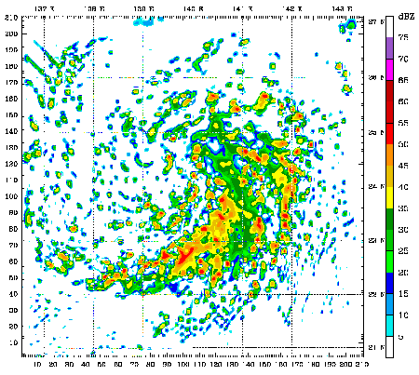
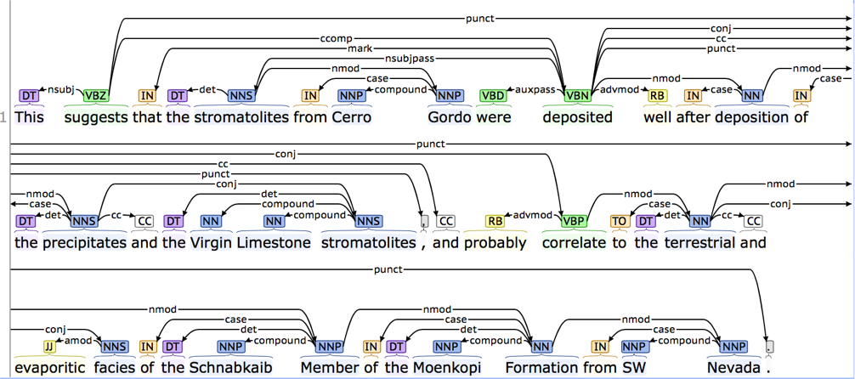
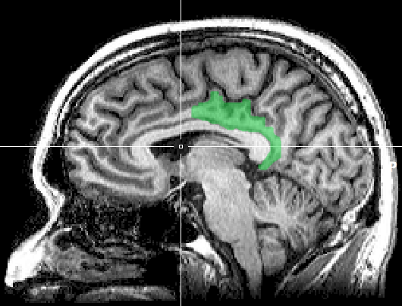
HTC Examples
text analysis (most genomics …)
multi-start simulations
parameter sweeps
statistical model optimization
(MCMC, numerical methods, etc.)
multi-image and
multi-sample analysis

Slide 14
Signs of HTC-able work
Any mention of numerous samples, images, models, parameters, etc.
Nearly anything written by the primary user (e.g. c/fortran, Python, R)
Break out of loops!
Common internal parallelism could really be HTC (e.g. Matlab’s ‘parfor’, ‘distributed server’, etc.)
Some community softwares that use multi-threading or multiprocessing (e.g. OpenMP)
many are simply looping over data portions or independent tasks
HTC-able: break up input (or ‘parameter’ space), turn off multi-threading, combine results
Long-running jobs (especially if non-MPI); see above explanations

Slide 15
Example Challenge
You need to process 72 brain images for each of 168 patients. Each image takes ~1 hour of compute time.
168 patients x 72 images = ~12000 tasks = ~12000 hrs
Conference is next week.

Slide 16
Distributed Computing
Use many computers, each running one instance of our program
Example:
1 laptop (1 core) => 12,000 hrs = ~1.5 years
1 server (~40 cores) => 750 hrs = ~2 weeks
1 MPI job (400 cores) => 30 hrs = ~1 days
A whole cluster (10,000 cores) = ~1 hour

Slide 17
What computing resources are available?
A server?
A local cluster?
Consider: Queue wait time? Can you program MP/MPI? Typical clusters tuned for HPC (large MPI) jobs may not be best for HTC workflows! Could you use even more than that?
OSG?
Other
EGI (European Grid Infrastructure)
Other national and regional grids
Commercial cloud systems (e.g. HTCondor on AWS)

Slide 18
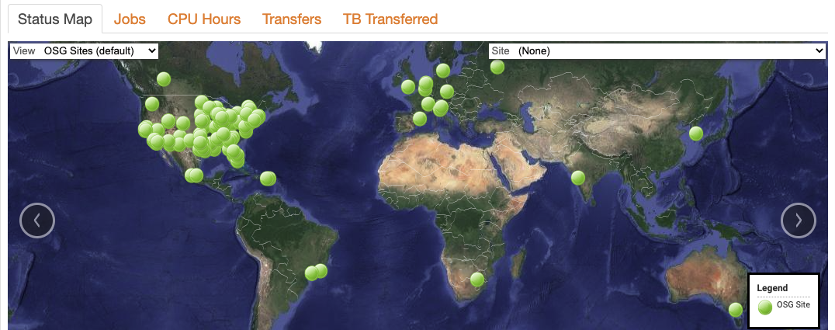
What is the OSG?
a consortium of researchers and institutions who share compute and data resources for distributed high-throughput computing (dHTC) in support of open science
display.opensciencegrid.org

Slide 19
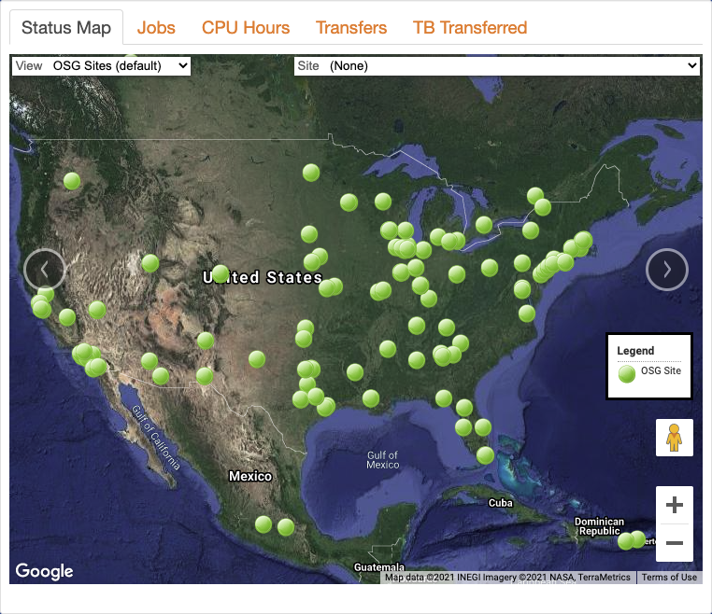
Who Participates?
Researchers
Science Gateways
Multi-Institution Collaborations
Atlas/CMS (Higg Boson), IceCube, South Pole Telescope, and others
Academic Institutions and National Laboratories that support the above
Campuses are critical to OSG’s ability to advance research.

Slide 20
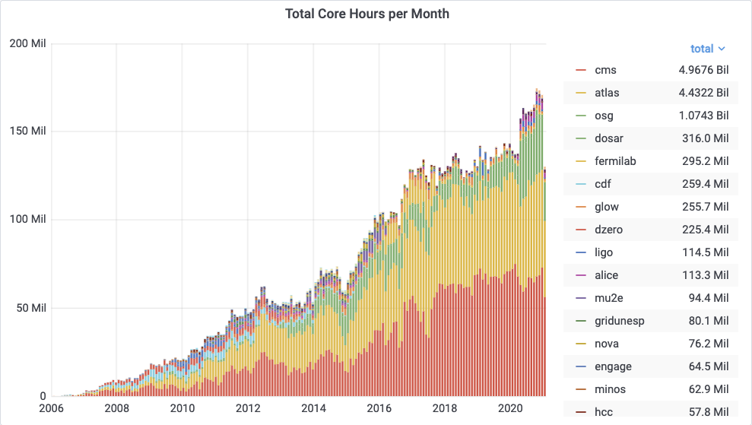
Research Communities (Pools) in the OSG
(“virtual organizations”)
>2 billion hrs in the last year

Slide 21
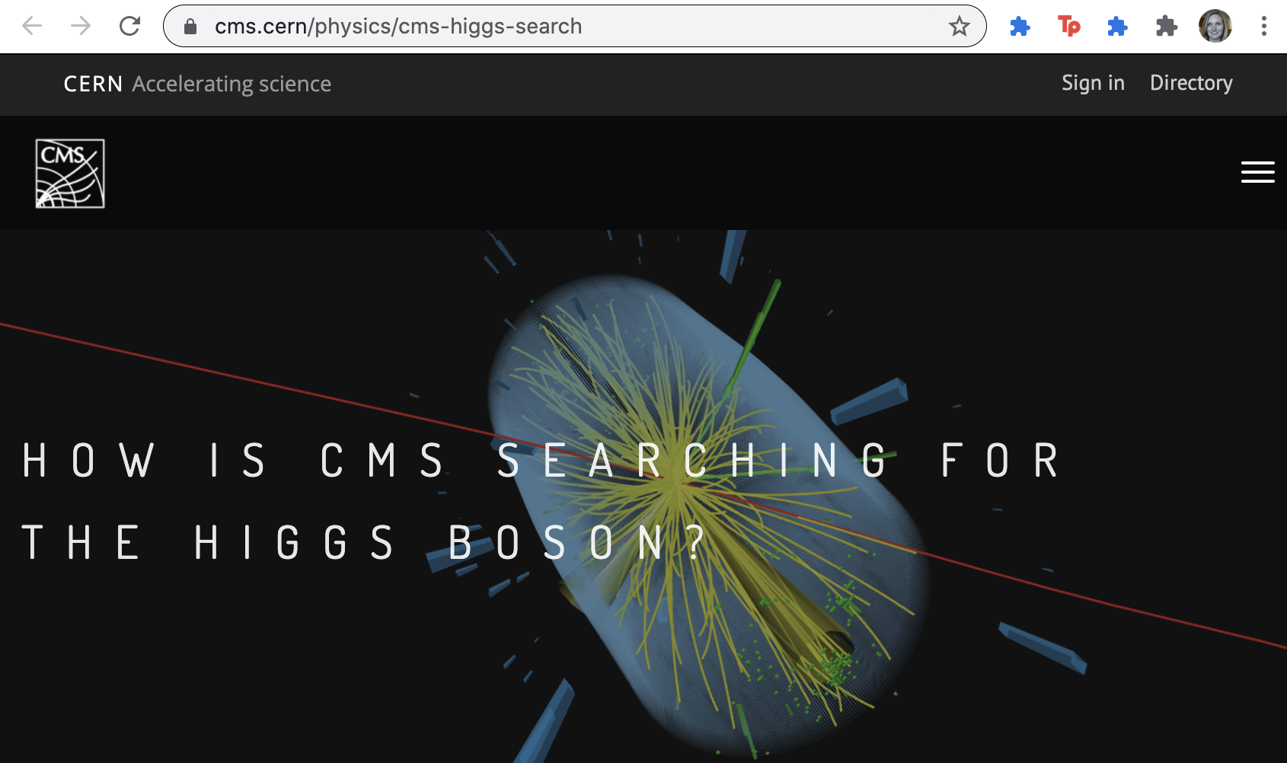

Slide 22
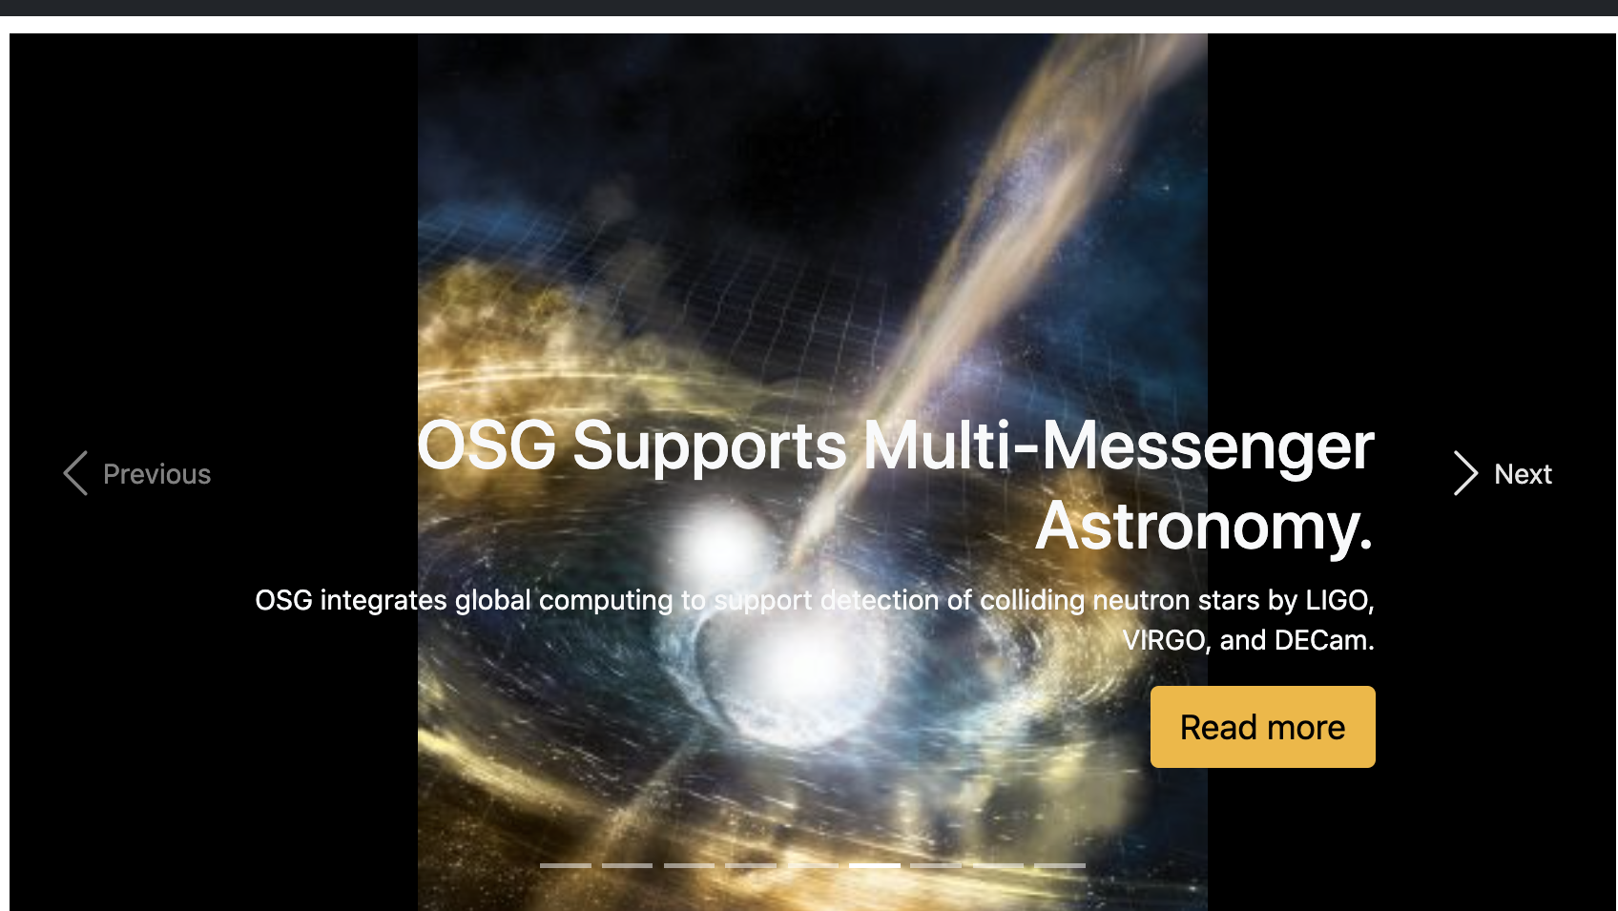

Slide 23
“Open Science Pool”
single researchers/groups (OSG Connect)
smaller multi-institution collaborations
campus access points
gracc.opensciencegrid.org

Slide 24
Can the OSPool Help?

Slide 25
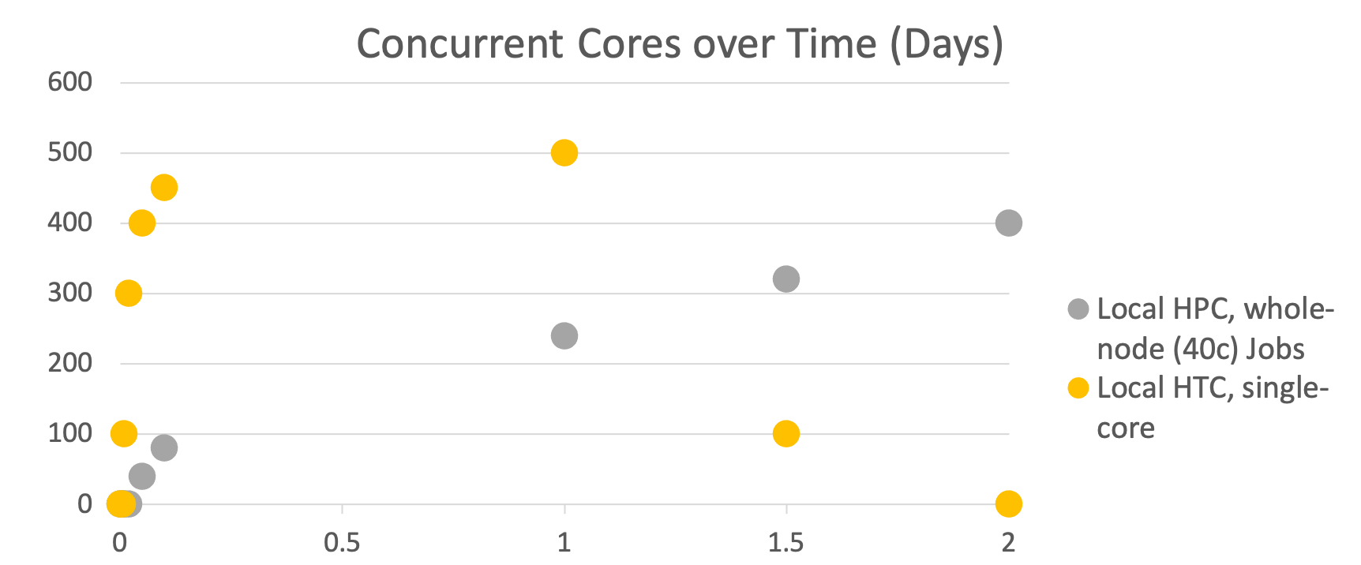
Hypothetical Throughput, 12k core hours

Slide 26
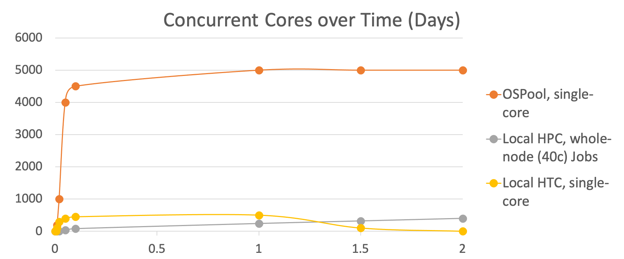
Hypothetical Throughput, 12k core hours

Slide 27
OSG Virtual School Content
Lectures: Tue-Fri, 10am CT & 2:30pm* CT
HTC via HTCondor
(d)HTC on the OSG
Software Portability for HTC
Data Portability for HTC
Bonus topics (2nd Mon-Tue): optional
Showcase (2nd Wed): science transformed by HTC
Lightning Talks+Close (2nd Fri): chance to show work
*presented ‘publicly’, via registration; all others for selected participants

Slide 28
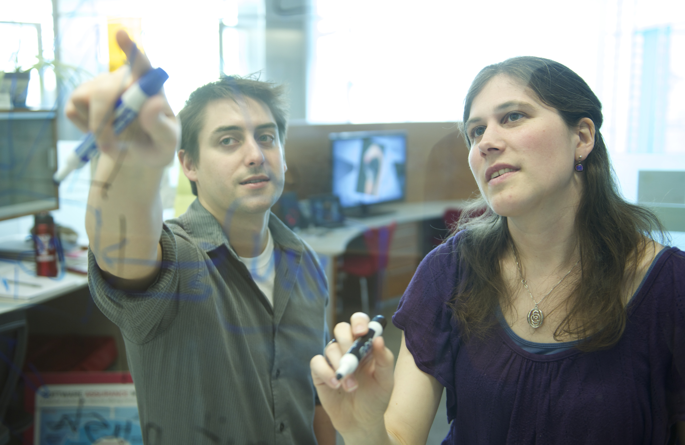
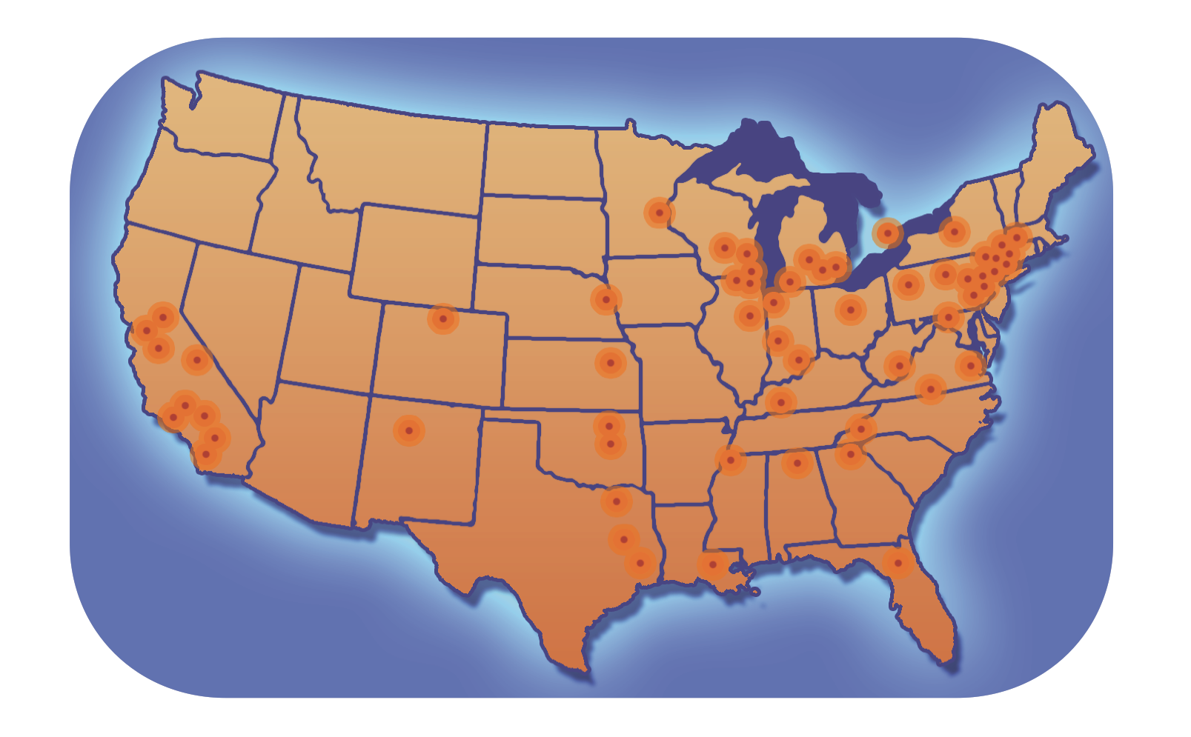
For Researchers and Campuses
Proactive, personalized facilitation and support for:
Individual researchers via OSG Connect
Institutions and large collaborations
Share local resources via the OSG
Locally-supported access points
data and identity federation
integration of cloud capacity
Local HTC Capacity
Learn from OSG’s Research Computing Facilitators
Presentations/Training in OSG compute execution, HTC Facilitation, and local HTC systems administration

